Slide 1
Digital Design Project
DESIGN TOPIC - Design an elevator system in a 3 storey building.

Slide 2
Block Diagram
Clock
Elevator
System
Block
Current floor output
Floor Input
Floor Level Sensor

Slide 3
Inputs
Buttons Inside Elevator | BUTTONS ON EACH FLOOR | Floor SENSOR
F1 | 1U | AF1
F2 | 2U/2D | AF2
F3 | 3D | AF3

Slide 4
Outputs
output | Description
Open | Lift door opens
Close | Lift door remains closed

Slide 5
State Table
P.S. | I/P | N.S.
F1/OPEN | F1 | F1/OPEN
F1/OPEN | F2 | F2/CLOSE
F1/OPEN | F3 | F3/CLOSE
F1/OPEN | 1U | F1/OPEN
F1/OPEN | 2U | F2/CLOSE
F1/OPEN | 2D | F2/CLOSE
F1/OPEN | 3D | F3/CLOSE

Slide 6
State Table
P.S. | I/P | N.S.
F2/OPEN | F1 | F1/CLOSE
F2/OPEN | F2 | F2/OPEN
F2/OPEN | F3 | F3/CLOSE
F2/OPEN | 1U | F1/CLOSE
F2/OPEN | 2U | F2/OPEN
F2/OPEN | 2D | F2/OPEN
F2/OPEN | 3D | F3/CLOSE

Slide 7
State Table
P.S. | I/P | N.S.
F3/OPEN | F1 | F1/CLOSE
F3/OPEN | F2 | F2/CLOSE
F3/OPEN | F3 | F3/OPEN
F3/OPEN | 1U | F1/CLOSE
F3/OPEN | 2U | F2/CLOSE
F3/OPEN | 2D | F2/CLOSE
F3/OPEN | 3D | F3/OPEN

Slide 8
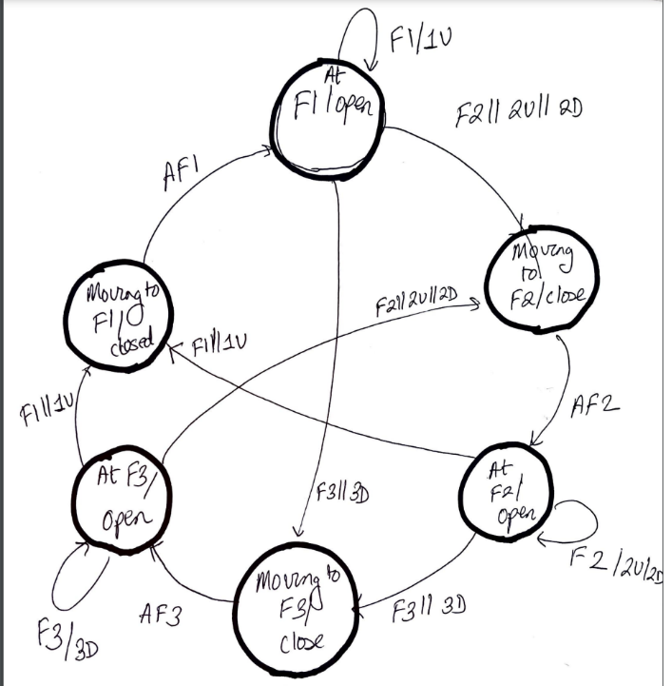
State Diagram

Slide 9
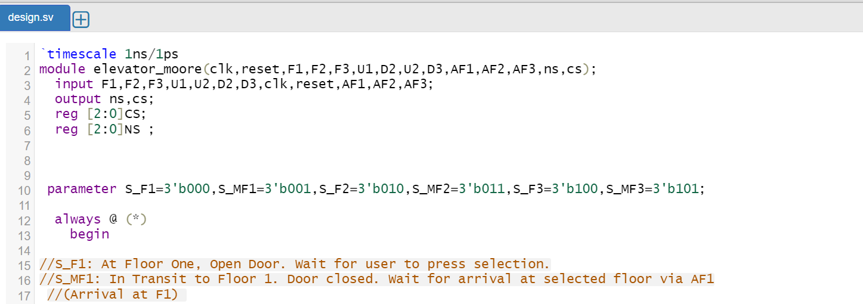
Verilog code-Initialisation

Slide 10
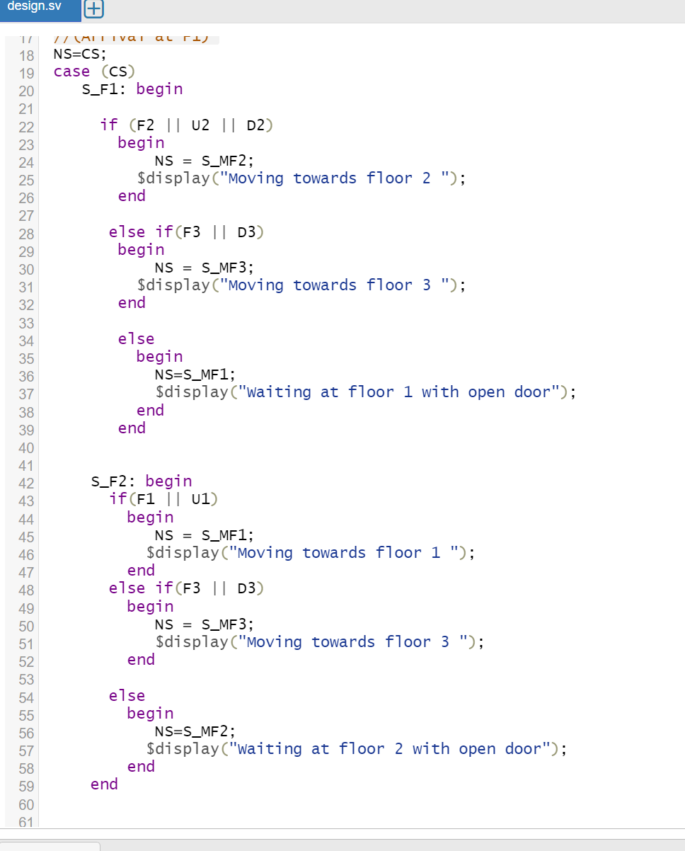
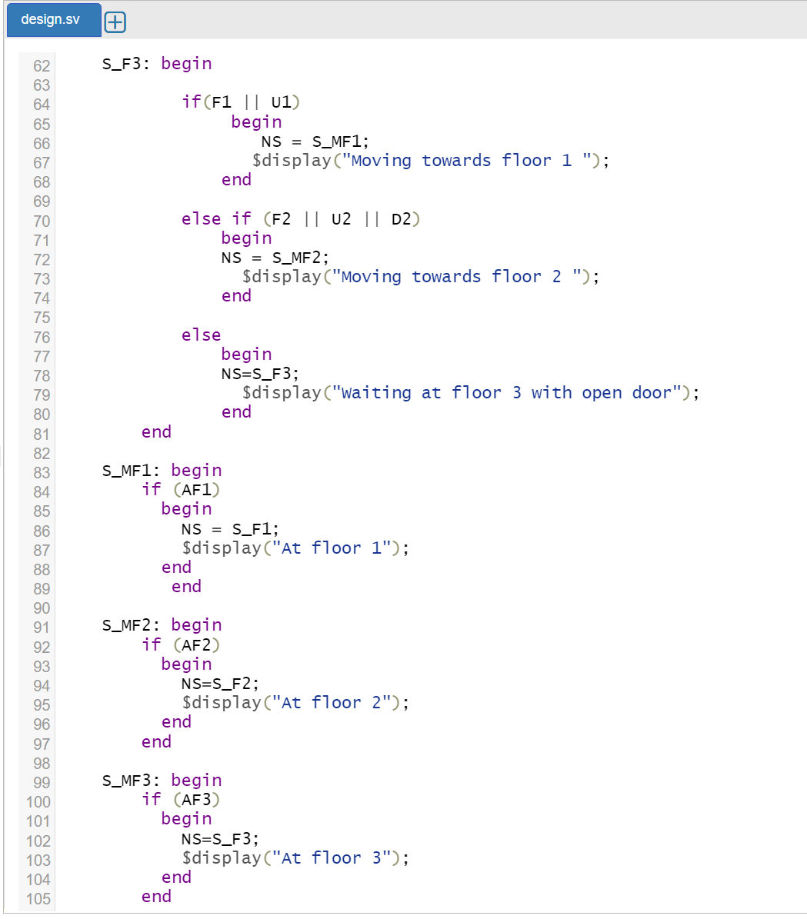
Verilog code-Cases

Slide 11
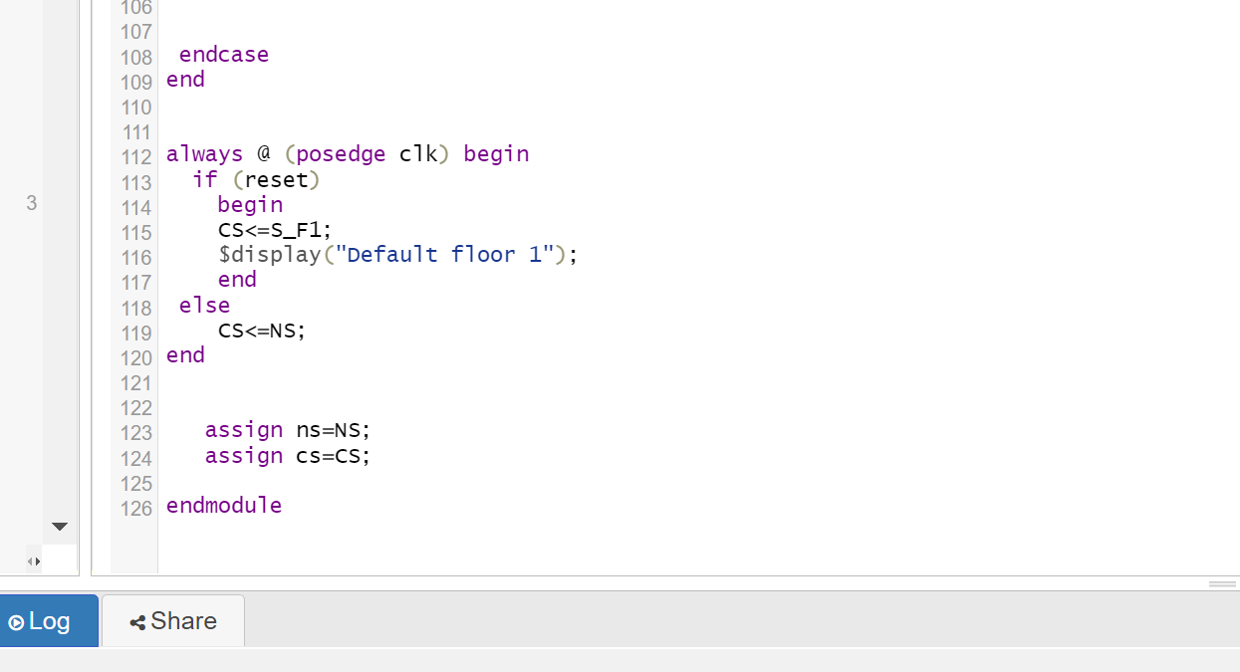
Verilog code-assignment

Slide 12
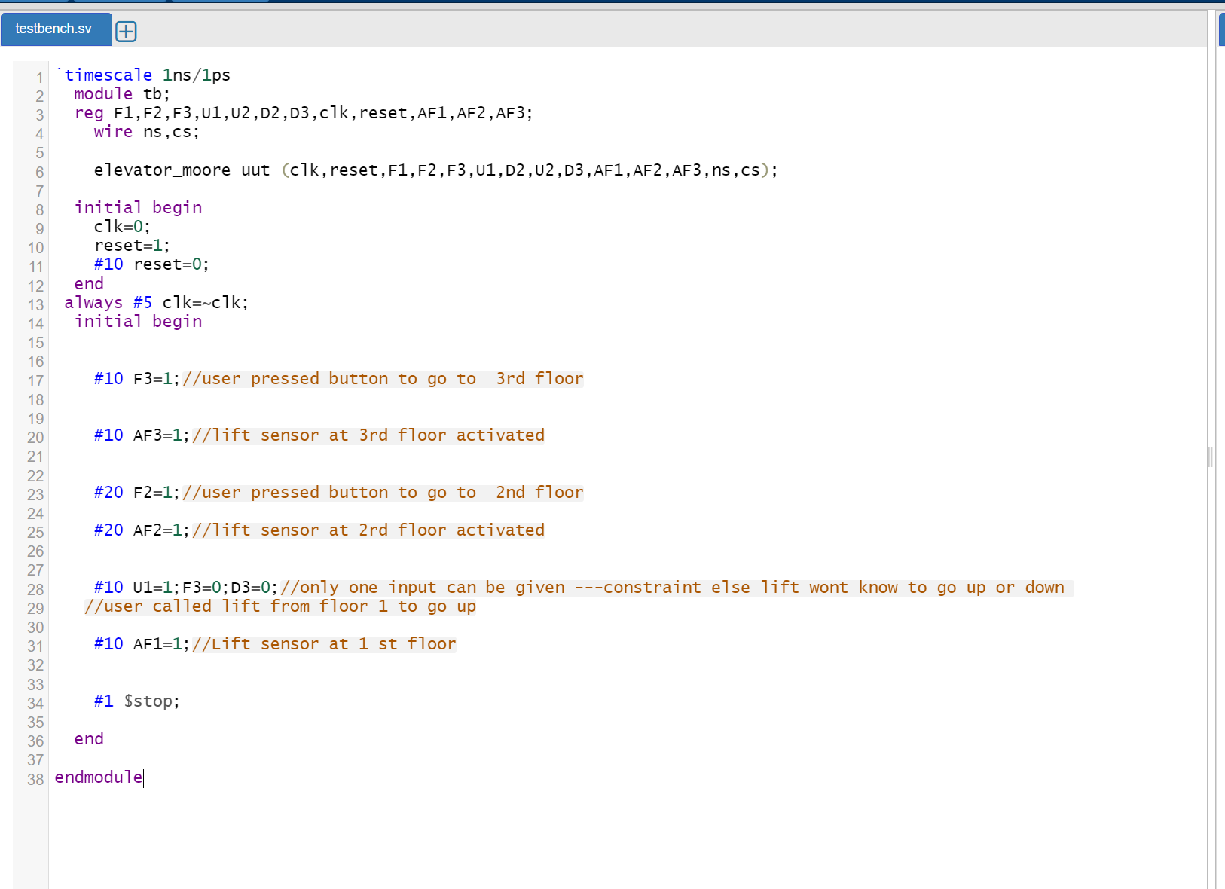
Verilog code-Testbench

Slide 13
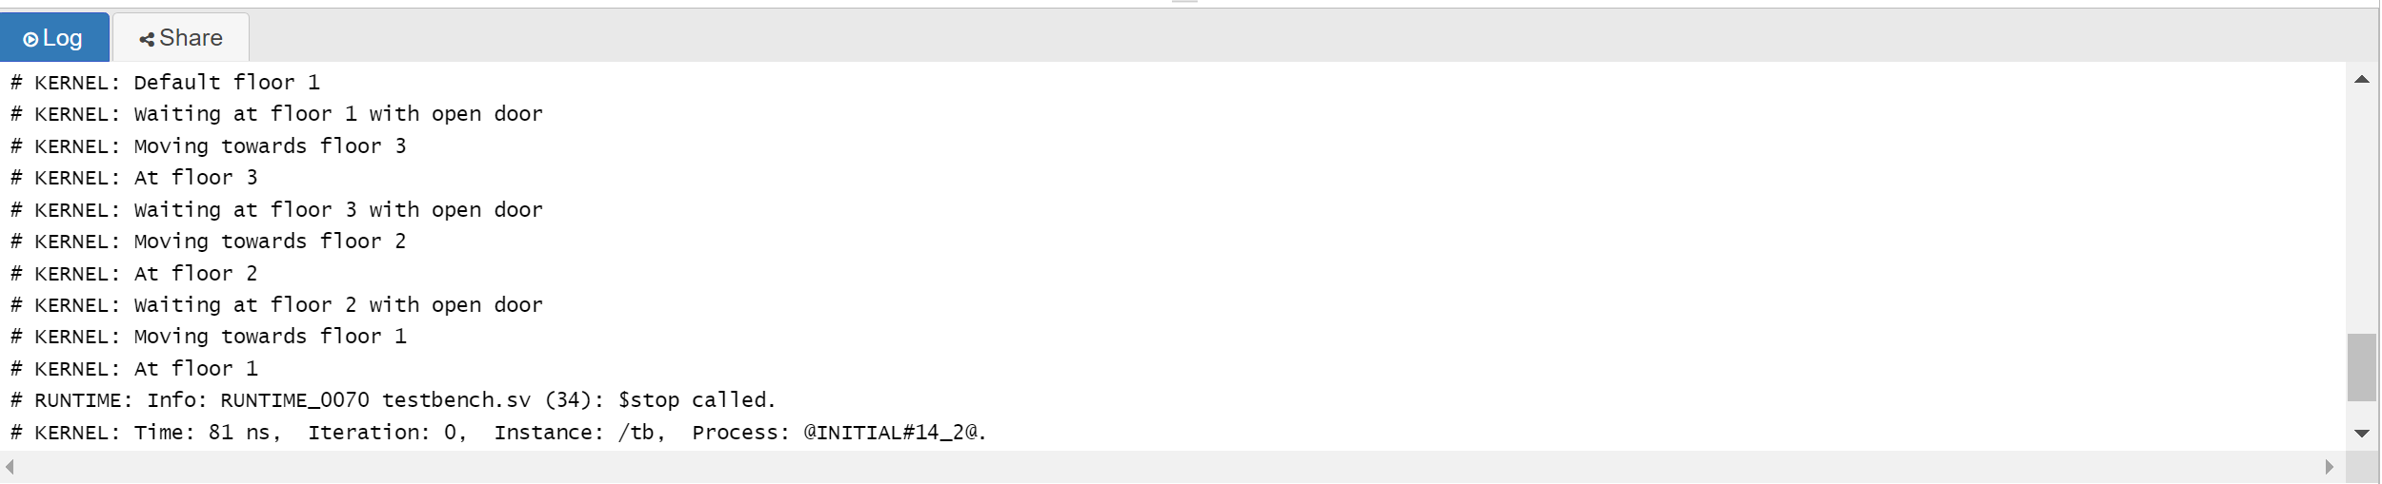
Verilog Output

Slide 14
Verilog code
https://www.edaplayground.com/x/MbwH

Slide 15
Thank You

